Slide 1
SUPER BOWL 2017
Edel, Isaiah, Pierce,

Slide 2
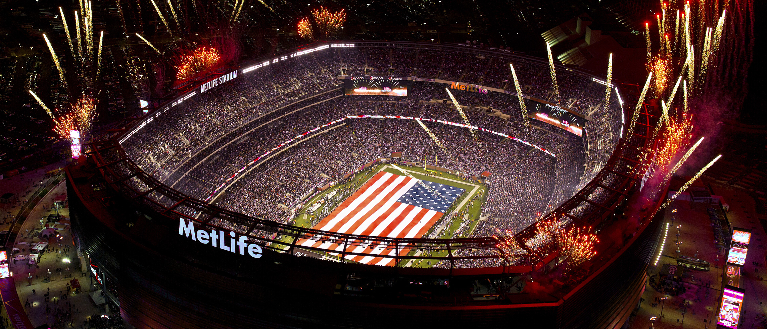
ABOUT OUR EVENT
We will start at a football game. At football games, there are of course football fans, so they will definitely be interested in going to the Super Bowl. We will play commercials on huge screens both inside and outside of the stadium.

Slide 3
Personal Selling
We will put up booth outside football games and let people look at all the different football t-shirts we can offer the fans. They will also be able to buy football props, like footballs and scum fingers.

Slide 4
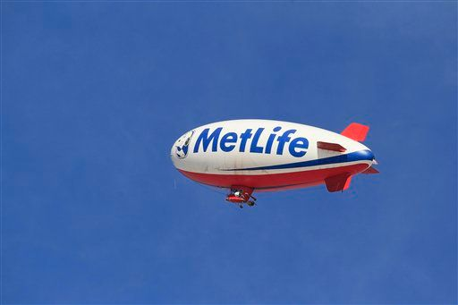
ADVERTISING
We are starting in January because the Super Bowl is in February.
We are going to advertise it on blimps and billboards.

Slide 5
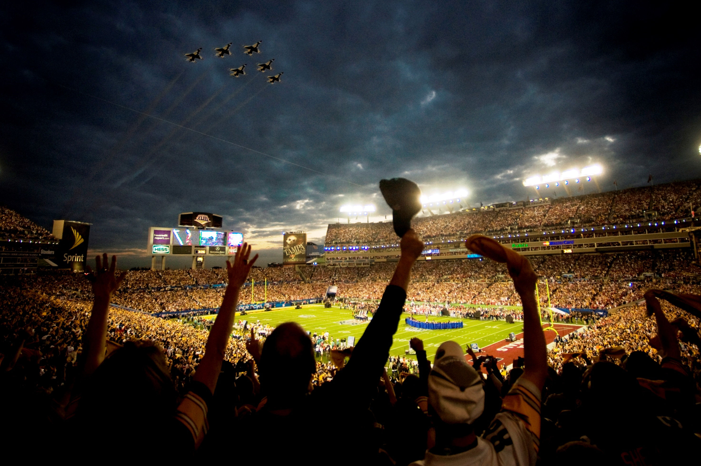
SALES PROMOTION
We will use billboards and blimps with jumbotrons in the weeks leading up to the event. That is to raise awareness and hype for the game around the stadium .

Slide 6
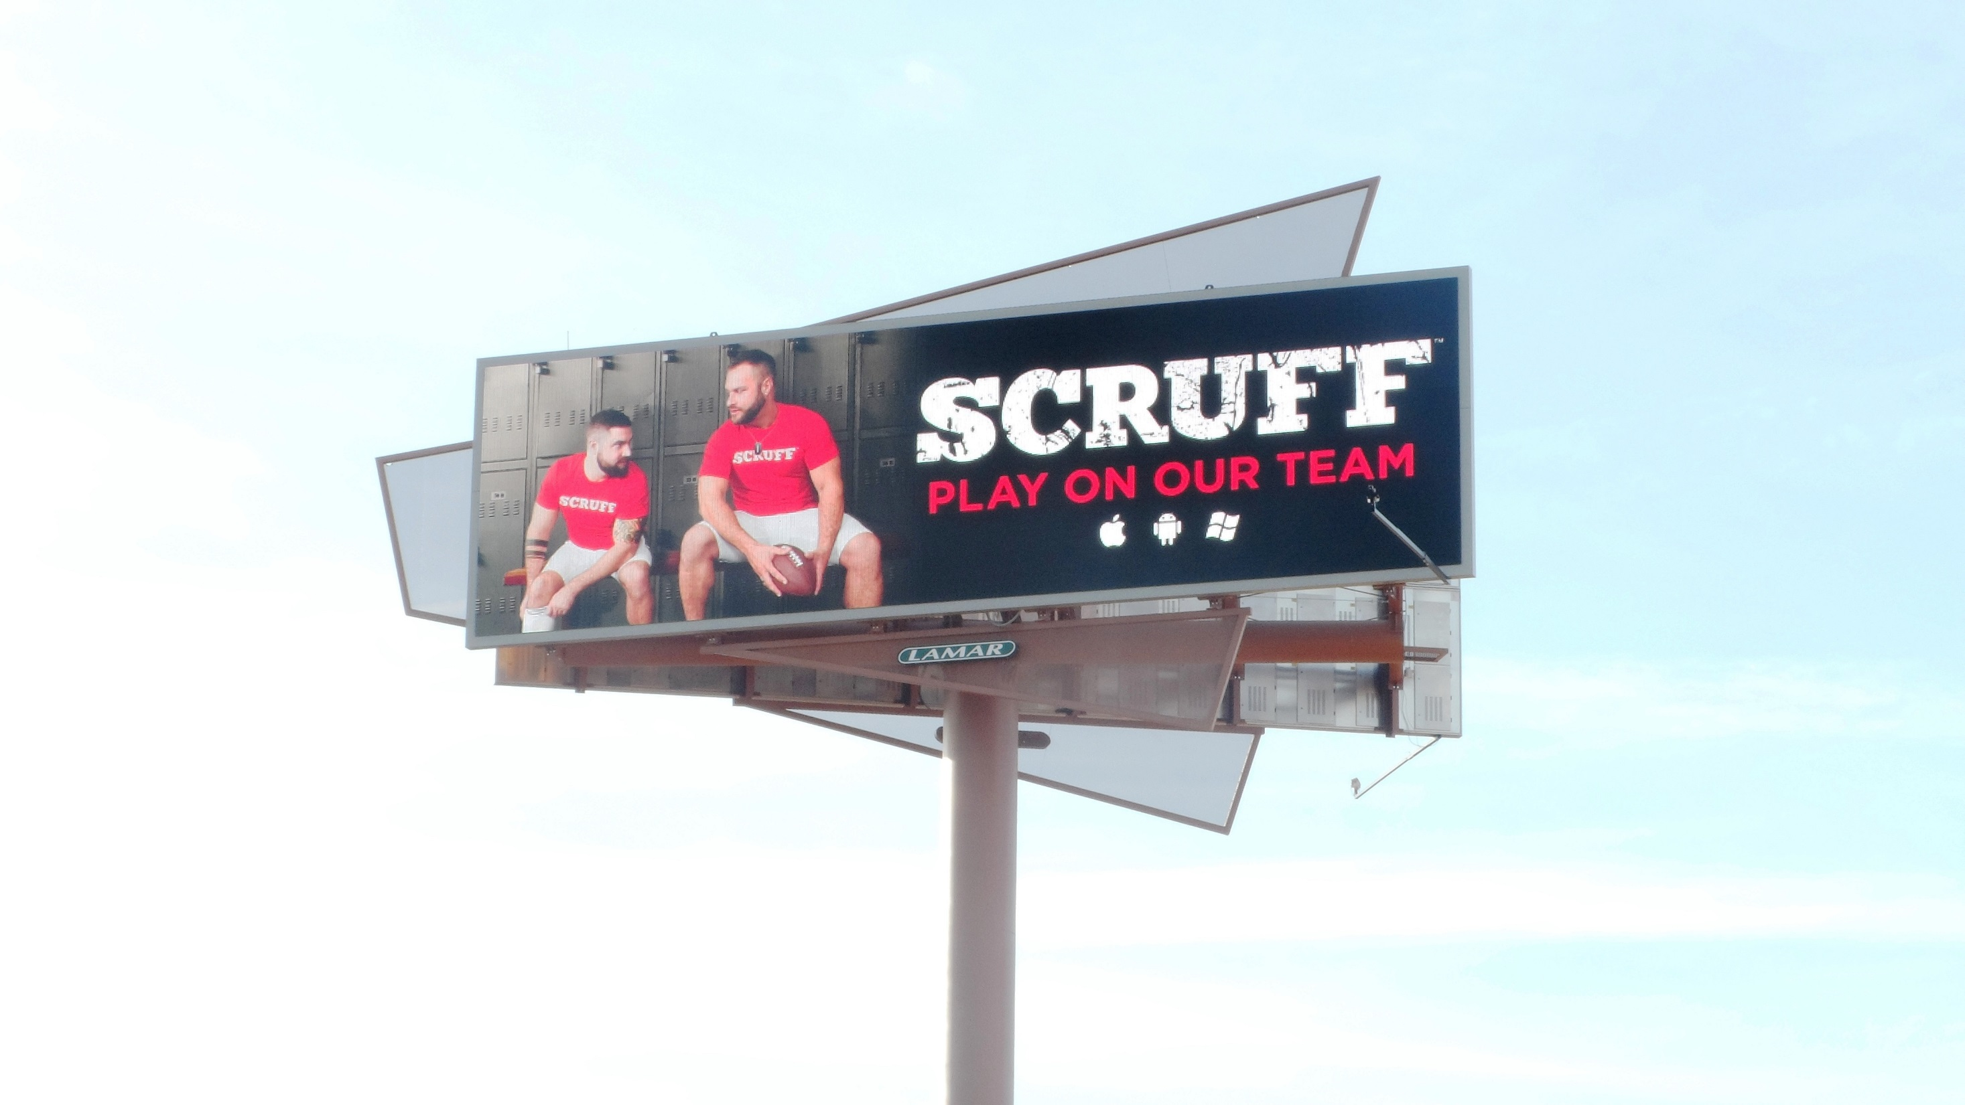
PUBLIC RELATIONS
We are going to start off at the mall and billboards or TV commercials. Its to create a positive attitude for the Super Bowl. We are going to do it as often as possible.

Slide 7
Sales Promotion
We will give fans coupons, premium/VIP tickets and product samples.

