Slide 1
Unit: Product Planning Product Life Cycle

Slide 2
What is a product?
Product- Anything offered to a market that might satisfy a want or a need.
A product includes everything a customer receives in exchange.
For example, a car purchase may include:
Car
Owner’s manual
Warranty
Free maintenance
Special status
Joy
Notes:
Have students list everything included when purchasing a digital camera, or a television.
A television might include: Owner’s manual, warranty, remote control, family time, happiness, hdmi cable

Slide 3
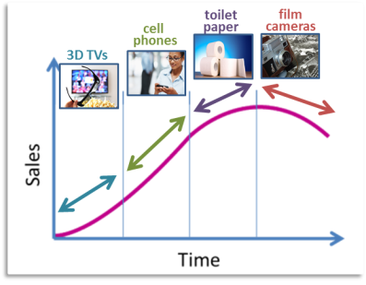
Product Life Cycle
A product life cycle represents the stages of the product on the market
Introduction- product first placed on the market
Growth- customers begin buying product
Maturity- sales slow down or level off
Decline- sales and profits drop
Notes:
Have students guess the stages of the following:
OLED (organic light-emitting diode) TVs- Introduction
Blueray- Growth
DVD- Maturity
Video Cassette- Decline

Slide 4
Product Line and Product Mix
Product Line- group of closely related products
Product Mix- all product lines for sale
Fresh produce
Beverages
Canned goods
Width of mix- number of different product lines sold by a company (ex. 3 product lines)
Length of mix- total number of products sold in all lines (ex. 14 fruit products)
Notes:
Width of the mix? 3 product lines (produce, canned, beverages)
Length of the mix? 14 fruit products

Slide 5
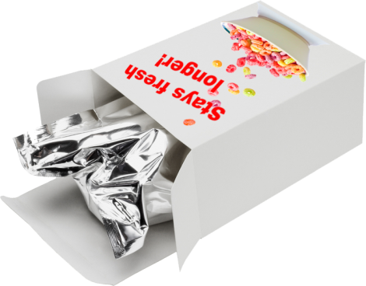
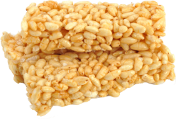
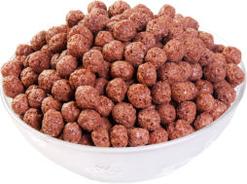
Managing the Product Mix
Businesses must make adjustments on a regular basis to maintain an effective product mix.
3 ways to adjust:
1. Change Existing Products
Product Modification
Product Extension
2. Delete Products
3. Develop New Products
DISCONTINUED
Notes:
Have students list products they use that have been modified or extended.
Have students used products that have been deleted from a product line?
What new products have students used?

Slide 6
Managing the Product Mix
Managing the number of products is a critical task.

Slide 7
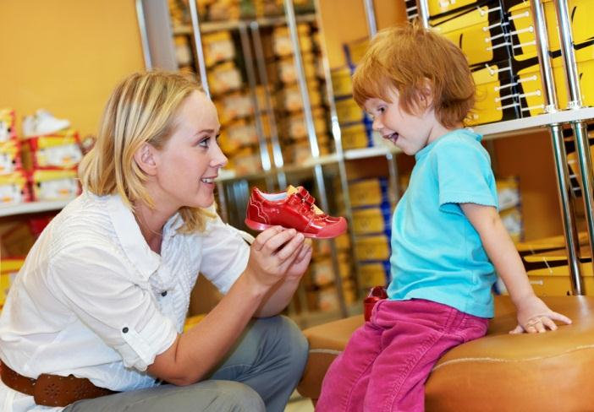
Classification of Products

Slide 8
Goods and Services
Good- A product you can touch
Service- A product you cannot touch
An interior designer giving advice to customers is a service. Or she can sell them items like carpet, paint, or furnishings. These are goods.
Notes:
Have students list as many goods and services as they can think of.

Slide 9
Consumer Products
Marketing consideration | Convenience | Shopping | Specialty
Customer buying behavior | Frequent purchase, little effort (planning, comparison), low customer involvement | Less frequent purchase, much effort (planning and comparison of brands on price, quality, style etc.) | Strong brand preference and loyalty, special purchase effort, little comparison of brands, low price sensitivity
Price | Low price | Higher price | High price
Distribution | Widespread distribution, convenient locations | Selective distribution, fewer outlets | Exclusive distribution in only one or a few outlets
Promotion | Mass promotion | Advertising and personal selling | More carefully targeted promotion
Examples | Toothpaste, magazines, laundry detergent | Television, furniture, clothing | Luxury goods (e.g. Rolex watch), designer clothing
Notes:
Have students list some examples of the three types of consumer products

Slide 10
Branding and Packaging

Slide 11
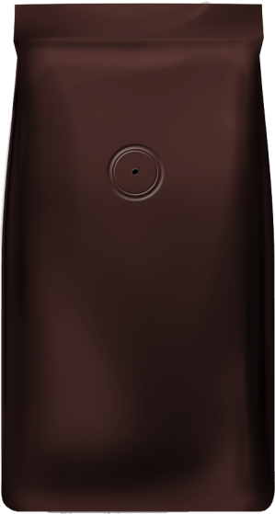
Brand- A product’s identity
Brand name- Verbal part
Brand mark- Visual part
Branding helps a seller define special qualities of their product
Customers expect brands to be consistent on quality
Customers develop loyalty to brands
Notes:
A brand is a product’s identity. It is a name, term, symbol, design, or any combination of these items that is used to distinguish a company and its products from all others.
A brand name is the verbal part of a brand. It may include letters, words, numbers, and symbols that can be spoken.
On the other hand, a brand mark is the visual part of a brand. It may include a distinctive design or symbols that cannot be spoken.

Slide 12
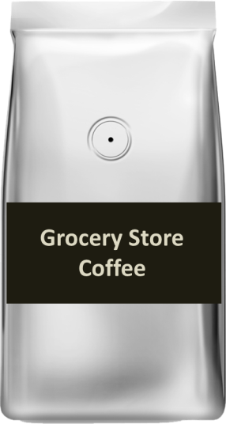
Generic Versus Brand Name
No brand name recognition
Sold at a reduced price
Minimal product promotion
Less promotion reduces company costs
Generic products:
Notes:
Ask students to list some brand name products, and then a generic coutnerpart.

Slide 13
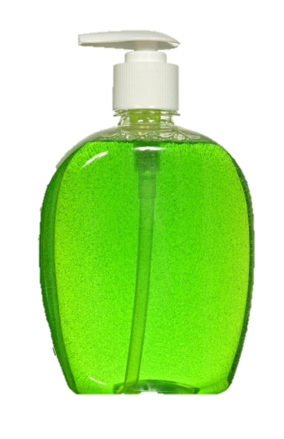
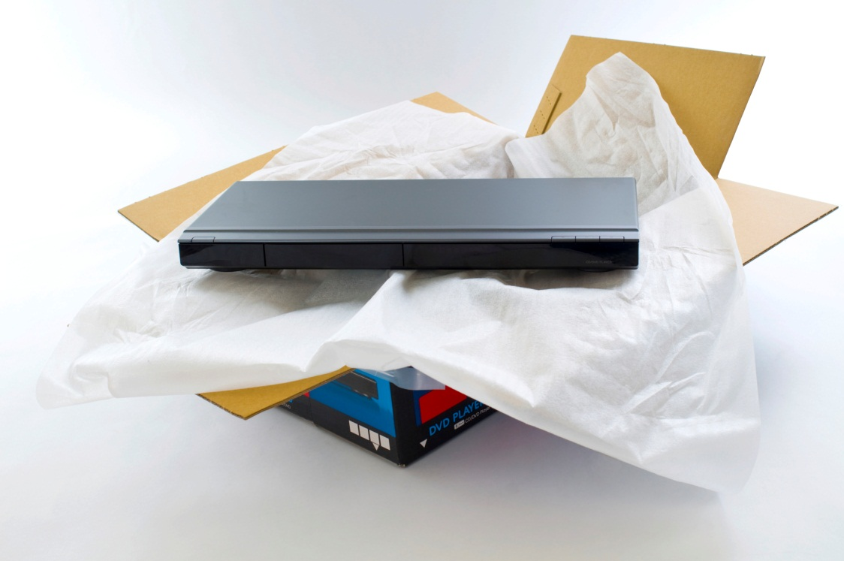
Packaging Purposes
Packaging- the container or wrapping for a product
Why is product packaging important?
Packaging can help a product stand out from the competition.
Packaging can make a product safer.
Packaging can make the product easier to use.
Packaging protects a product during shipping.
Labels on packaging help the customer make a buying decision by providing information.
Notes:
Before revealing, ask students to list reasons why they think product packaging might be important.

Slide 14
Juice Box Marketing Project
Juice-Tree is a company that sells fruit juices nationwide. They have traditionally sold their juice in plastic bottles.
Now they want to repackage their product to better compete with other juices on the market. They want to sell their juice in single-serving juice boxes. They also want to update their image to attract children and their parents to buy their juice products.
You will design a juice box package that meets the marketing requirements of the company.

Slide 15
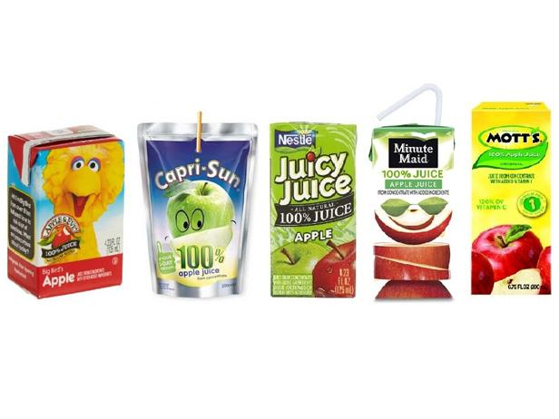

Slide 16
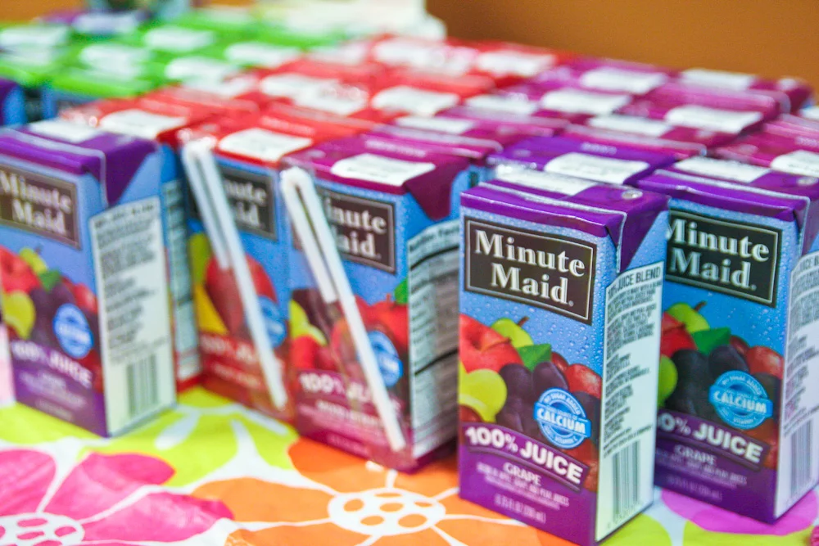

Slide 17
Juice Box Marketing Project Rubric
The Final juice box package design should include the following: | Points
Required information: Student information: name, class period, date Product information: Manufacturer’s name: Juice Tree Product name: ______ Juice Amount in package: 10 FL OZ, 296 ml Marketing phrase: The Juice That Makes You Smile Nutritional Information: Calories 150, Fat 0g, Vitamin A 100%, Vitamin B 100% | _____ of 30
Design meets client requirements for updated juice box packaging that attracts children and their parents to buy their juice products Design is attractive in regards to color, artistry, creativity, use and placement of elements Design shows creativity | _____ of 50
Assembly: o Package is assembled neatly and correctly | _____ of 20
TOTAL | _____ of 100

