Slide 1
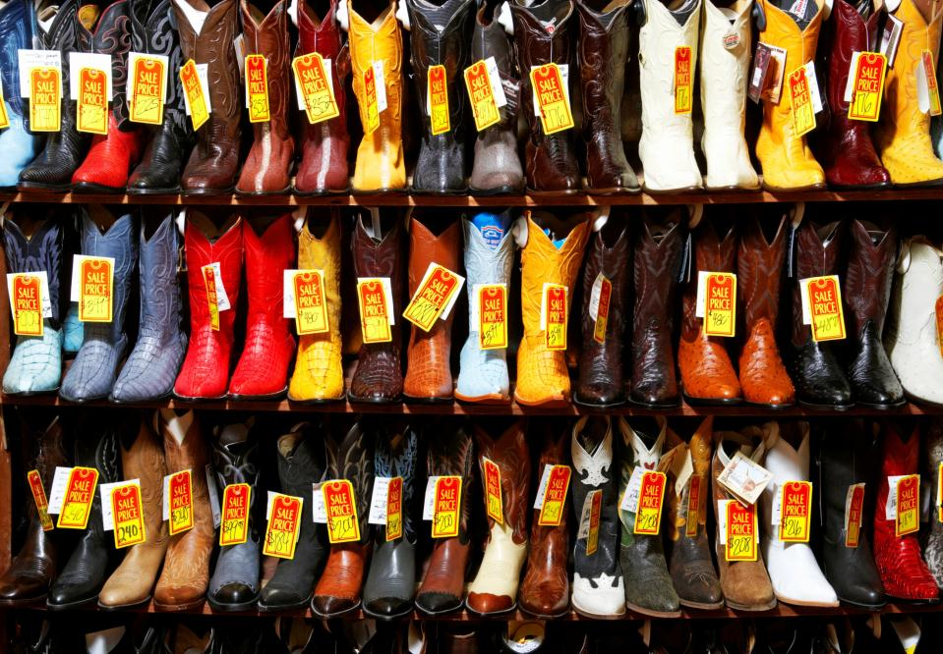
Unit: Pricing, Promotion & Distribution Lesson 1: Pricing

Slide 2
Lesson 1 – Pricing
Objectives:
Name factors that affect pricing.
Identify pricing objectives and methods.
Describe customer perception regarding price.

Slide 3
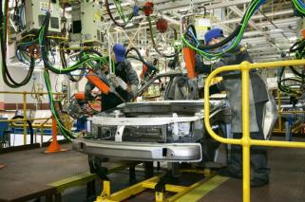
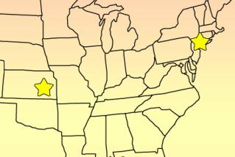
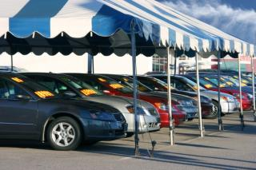
Price
Price- The value place on a product
Factors that affect price:
Cost of making the product
Cost of running the business
Price competitors charge
Demand for the product

Slide 4
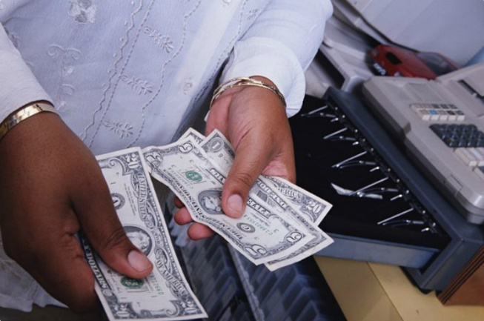
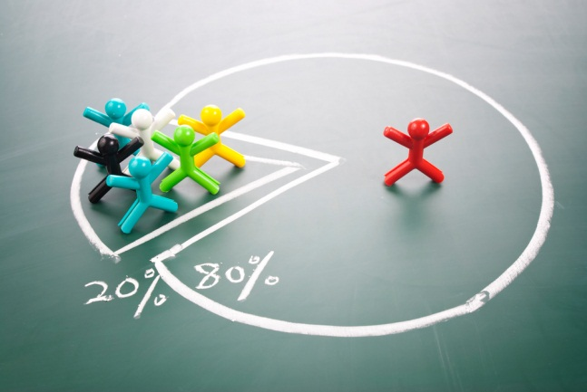
Pricing Objectives
One objective of pricing is to make a profit, but there are other objectives to consider...
Maximize profits
Increase market share
Match the competition

Slide 5
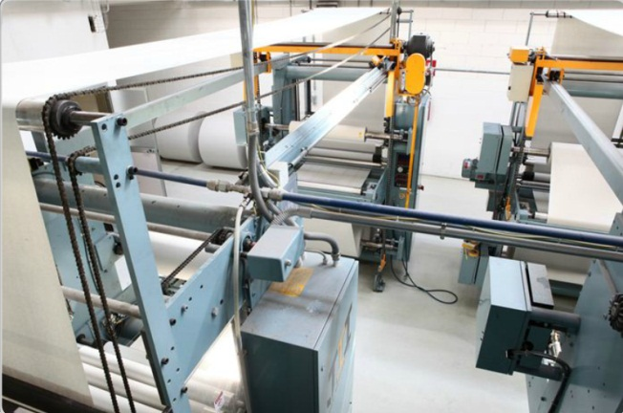
Pricing Methods
Businesses generally apply a combination of three basic pricing methods:
Cost-oriented
Demand-oriented
Competition-oriented

Slide 6
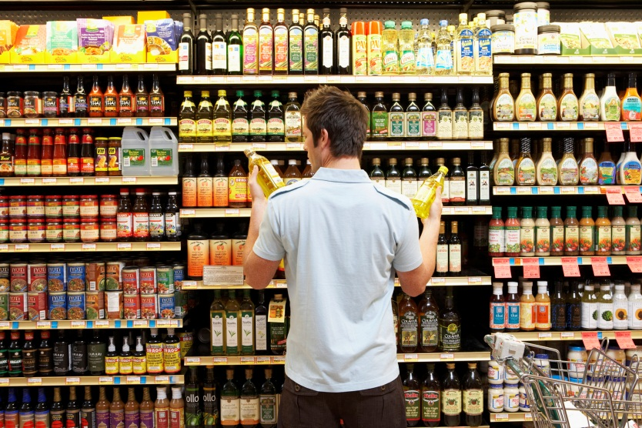
Customer Perception
It’s hard to know for sure if you’ve found the right price until you consider how the customer perceives it.
Notes:
Ask students to think about a time when price affected their purchase.

Slide 7
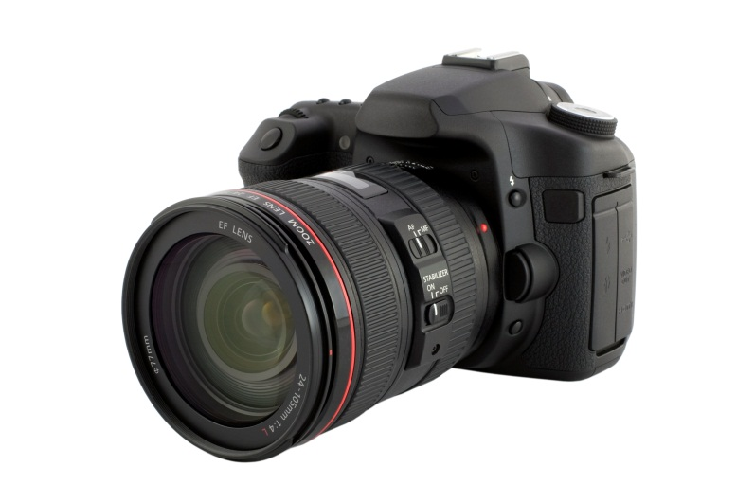
Customer Perception
Digital camera
$2,000
Dinner for two at a cafe
$50
Concert t-shirt
$28
Notes:
How do students perceive the prices on this slide? Too high? Too low? Just right?
Have the students explain why they made the choice that they did.

Slide 8
Unit: Pricing, Promotion & Distribution Lesson 2: Promotion

Slide 9
Lesson 2- Promotion
Objectives:
Explain the purpose of promotion.
Identify four different types of promotional activities.
Describe the importance of integrated marketing communications.

Slide 10
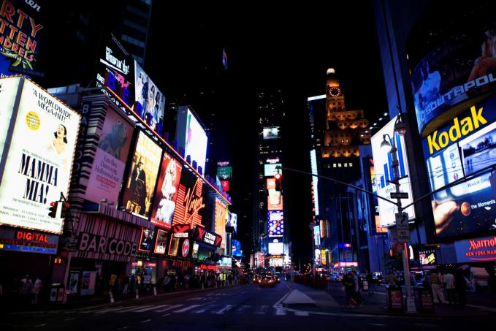
Promotion
any form of communication that a business uses to inform, persuade, or remind potential customers about their goods and services

Slide 11
Advertising
Pay money to influence people regarding a product
Does not use direct person-to-person contact
Many forms: print, digital, and broadcast

Slide 12
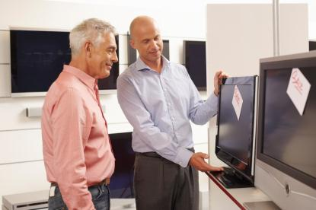
Personal Selling
Direct communication between the sales person and the customer
One on one, or group presentation
Relies on skills and knowledge of the sales person
More expensive, more persuasive

Slide 13
Sales Promotions
Incentives used to get people to buy a product
What are some common types of sales promotions?
Free Samples/ Giveaways
Coupons
Rebates
Premiums
Point-of-Sale displays
Trade show
Notes:
Ask students to think of some promotions before revealing the answers.

Slide 14
Public Relations and Publicity
Public relations involves the ongoing effort to foster positive relationships between an organization and various public groups
Customers, employees, stockholders, suppliers, community, etc.

Slide 15
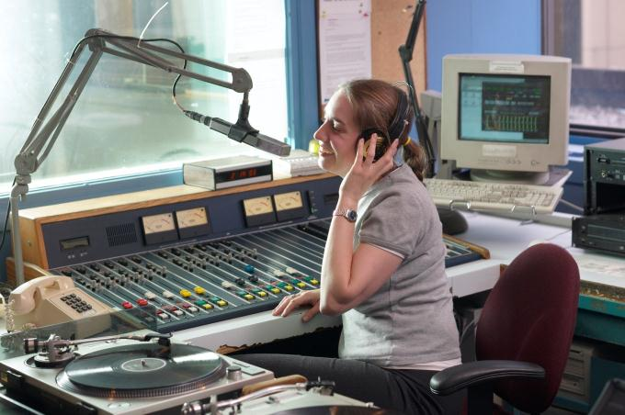
Public Relations and Publicity
FREE
Placing information about goods, services, or companies in the general media

Slide 16
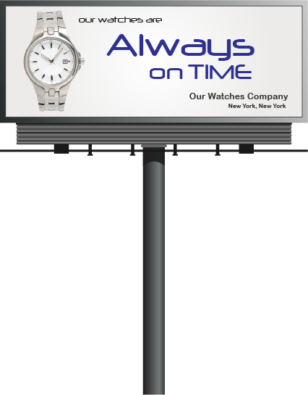
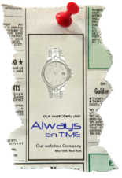
Integrated Marketing Communication
Coordinating all the promotional methods so that a consistent message is sent to customers

Slide 17
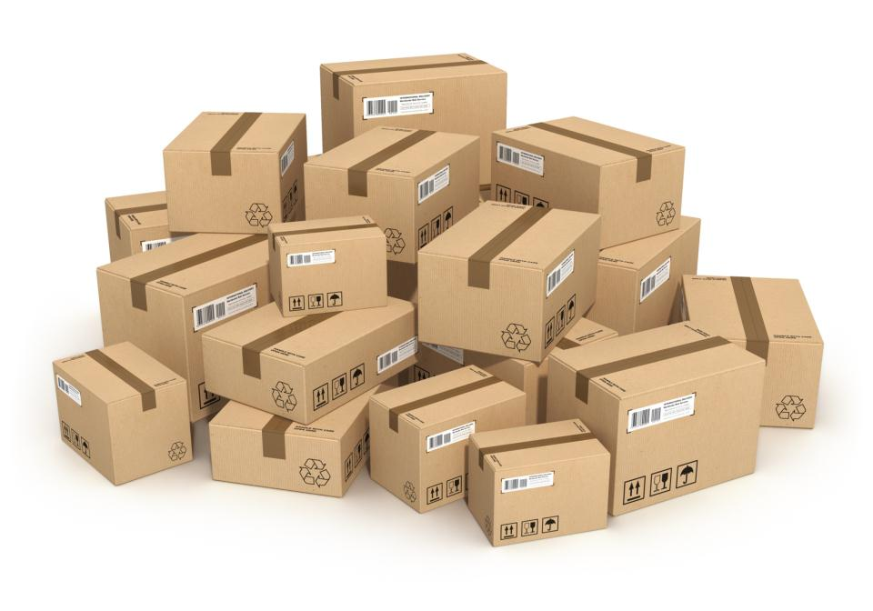
Unit: Pricing, Promotion & Distribution Lesson 3: Distribution

Slide 18
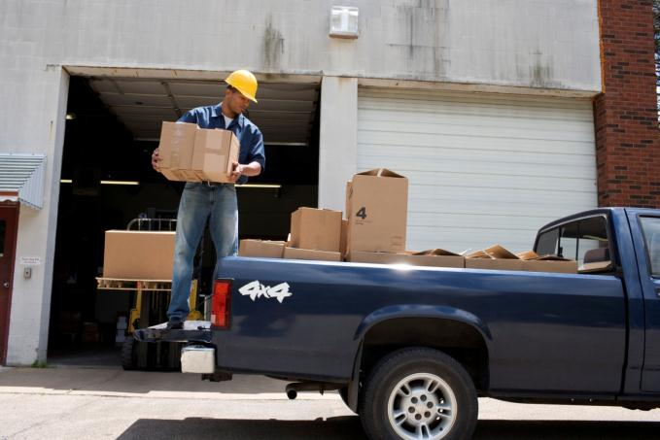
Lesson 3- Distribution
Objectives:
Determine how place affects marketing.
Identify channels of distribution.
Describe physical distribution.

Slide 19
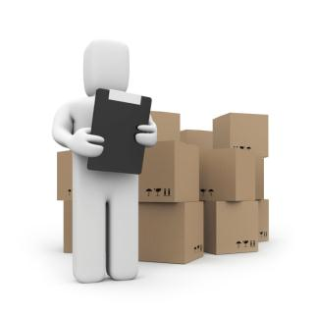
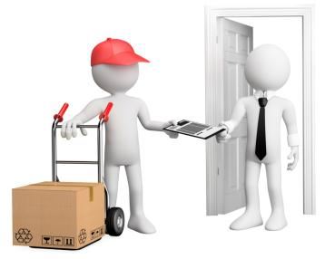
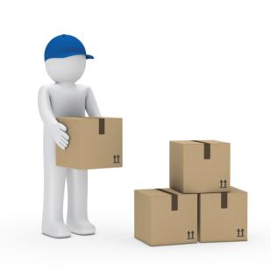
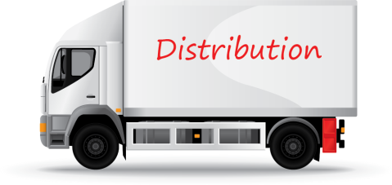
Place
Place refers to distribution-- how to get the product to the right people, in the right amounts, at the right time and place
Right place
Right people
Right amounts
Right time

Slide 20
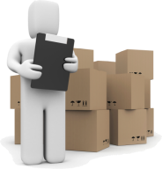
Place/ Distribution
Distribution involves two main elements:
Distribution
Channels of
Distribution
Physical
Distribution

Slide 21
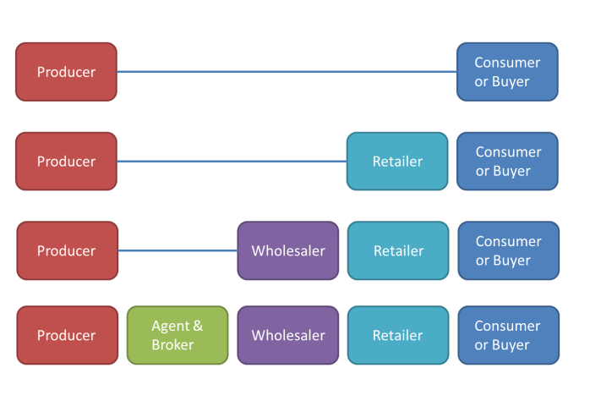
Channels of Distribution
Some producers choose to use a direct channel, where they sell their products directly to the customer. However, many products are passed through middlemen, or intermediaries, before they reach the end customer.
Notes:
A retailer is an intermediary that sells products directly to an end customer. There are both store retailers and non-store retailers.
---------
A wholesaler is an intermediary that sells to another intermediary. Wholesalers purchase huge quantities of products from many different businesses. They own this merchandise until they break it up into smaller shipments and sell them to other businesses.
----------
Agents and brokers connect sellers and buyers, but they do not own any merchandise. They are usually paid a commission, or percentage of the sales price. Agents are often hired on a long-term basis and deal with a few related products that meet the needs of many customers. Brokers are often hired on a temporary basis and match many different sellers and buyers.

Slide 22
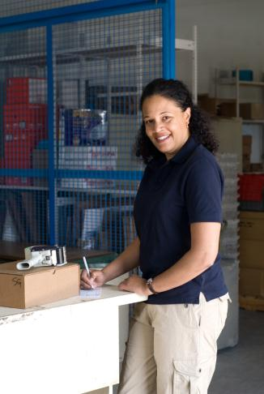
Physical Distribution
Products are moved through the distribution channel using a combination of different business functions.
Warehousing
Materials handling
Inventory management
Order processing
Transportation
Notes:
Warehousing concerns activities for receiving and storing goods, and preparing them for reshipment. A business may use its own warehouse or rent space in a public warehouse.
----------
Materials handling refers to the actual physical handling of goods, both in warehouses and during transportation. Proper handling reduces breakage and spoilage, and can even improve how space is used in the warehouse.
----------
Inventory management concerns decisions about how many goods and other materials to keep in stock. Keeping too little stock can interfere with production schedules or sales. But keeping too much in stock leads to unnecessary increases in costs, so there needs to be a balance. Businesses often rely on technology and software to help control inventory.
----------
Order processing concerns how to manage both incoming and outgoing orders. You need to figure out which processes would be most efficient for your customers as well as your suppliers.
----------
Transportation refers to the shipment of products to customers. Modes of transportation include trucks, airplanes, railroads, water carriers, pipelines, and even online transmission.

