Slide 2
Objectives
To obtain knowledge concerning the various organizational structures associated with business.
To gain an understanding of each type of organizational structure.
To learn the advantages and disadvantages of various organizational structures.

Slide 3
Main Menu
Introduction to Organizational Structures
Organizational Details Affecting Structure
Ways to Divide Work
Basic Business Structures

Slide 4
Introduction to Organizational Structures

Slide 5
What is an Organization?
An organization is a systematic grouping of individuals brought together to accomplish a goal
examples include:
businesses and companies
school and club organizations
nonprofit or religious affiliations

Slide 6
Common Characteristics of Organizations
Each organization has:
a purpose
employees or members
a systematic structure

Slide 7
Organization Purpose & Employees
The purpose of an organization is normally expressed in a goal or set of objectives for the organization to accomplish
An organization’s employees or members are the driving force in accomplishing a purpose; therefore good employee management and organizational structure is essential

Slide 8
Systematic Structures of an Organization
Define the various roles of members
Set limits on employee work behavior
Create rules and regulations
Vary widely from organization to organization
Adapt to the environment in which an organization is located

Slide 9
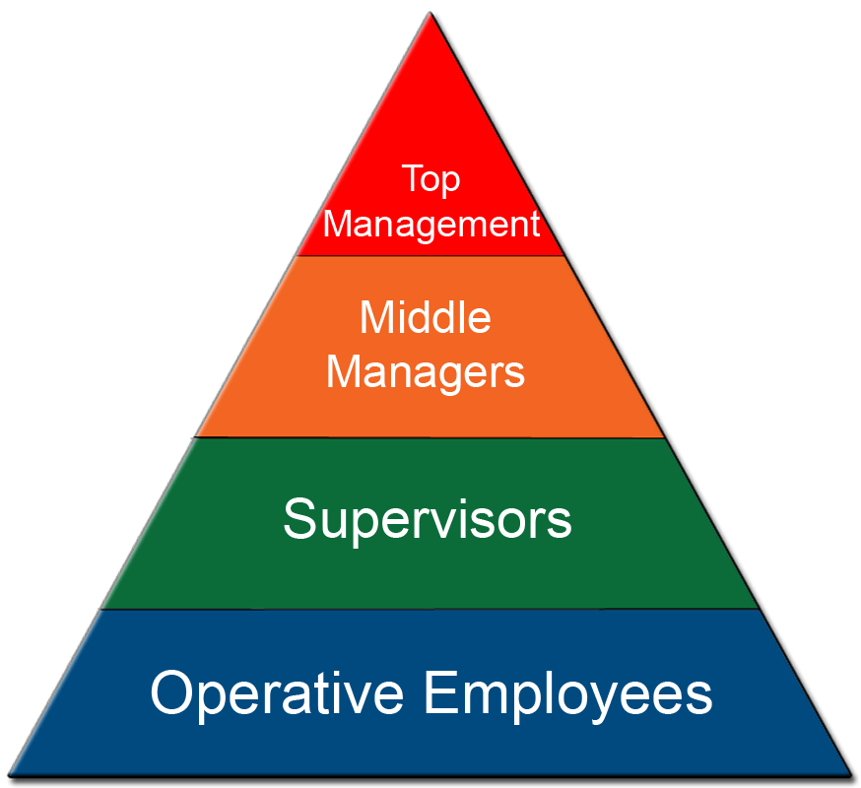
Organizational Levels
Most organizations can be divided into four basic levels:

Slide 10
Operative Employees
Make up the base level of the pyramid
Produce an organization’s goods and services
Generally do not manage or oversee the work of other employees
examples include:
salesperson in a retail store
teller at a bank
assembly line worker

Slide 11
Supervisors
Are a part of an organization’s management team
Oversee the work of operative employees
Are considered first-level managers
examples include:
assistant manager
department chair
head coach
shift supervisor

Slide 12
Middle Managers
Are employees who manage other managers
Are responsible for establishing and achieving the goals of a specific department or region set by top management
examples include:
director of marketing
region manager
high school principal
vice president of a department

Slide 13
Top Management
Sets an organization’s goals and objectives
Develops methods for achieving goals and objectives
Is the head of the organization
examples include:
chief executive officer
president
chairman of the board
senior vice-president

Slide 14
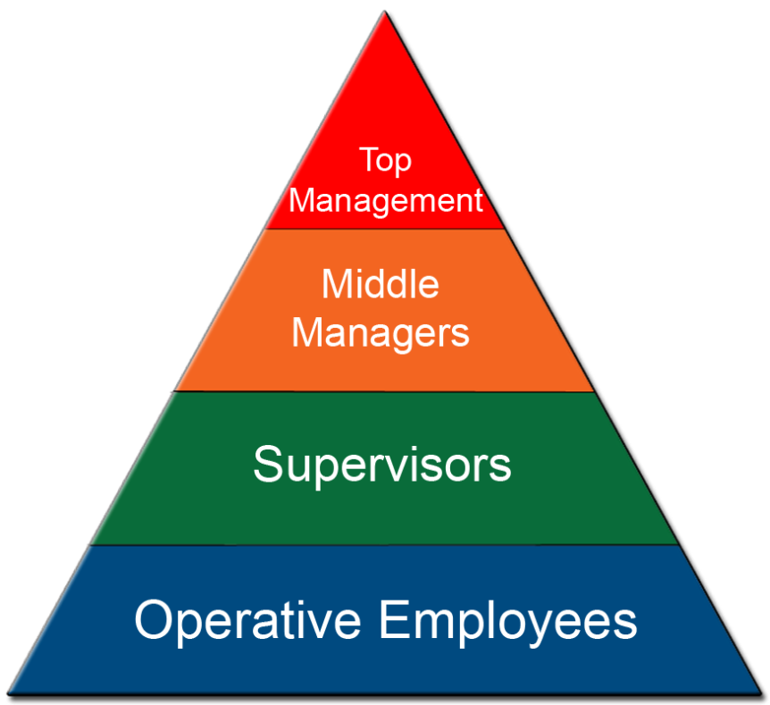
The Management Process
Can be formed and carried out by upper management positions through this systematic division of individuals

Slide 15
The Management Process
Refers to accomplishing goals and objectives effectively and efficiently
Involves using resources competently
Always has an end goal of achievement
Is accomplished through a specific organizational structure

Slide 16
Social Responsibilities of Managers
Include:
protecting the welfare and interest of the community along with their own company
responding to the demands of society
reacting to changes in social demands

Slide 17
Social Responsibilities of Managers
Are implemented by:
written commitments
supportive procedures
visible actions

Slide 18
Organizational Structures
Arrange and group jobs based on specific tasks in order to enhance efficiency
Increase the effectiveness of internal communication and reporting
Help with conflict management
Establish a chain of command
Can be formal or informal

Slide 19
Adaptive Organization
Are designed by:
communicating consistently
reinforcing the importance of innovation
collaborating effectively with employees, departments and groups
networking with outside organizations

Slide 20
Informal Structures
Are laid-back and undefined
Involve employees completing tasks which may not always fit their job description
Are normally found in smaller businesses with fewer employees
Allow for social interactions and preferences

Slide 21
Formal Structures
Are clearly defined and organized
Can be found in any business large or small
Can be charted or described visually
Include specific organizational details such as:
work specialization
span of control
chain of command
authority

Slide 22
Organizational Details Affecting Structure

Slide 23
Work Specialization
Occurs when a job is broken down into a number of steps which are each completed by a different individual
example of work specialization:
assembly line workers
Requires an individual to complete the same small task over and over again in order to contribute to a final project

Slide 24
Work Specialization
Can cause worker boredom, fatigue and stress
Is mainly used by supervisors to design jobs

Slide 25
Span of Control
Is the number of employees a supervisor can direct
Varies from supervisor to supervisor
Is affected by the supervisor’s:
experience
skill level
level of training
Is directly related to:
the type of job being supervised
complexity of tasks
rules and regulations

Slide 26
Chain of Command
Is the principle in which an employee should have only one supervisor to whom he or she is responsible
Decreases conflicting demands and priorities
Allows easier allocation of tasks
Is a formal system of employee communication

Slide 27
Authority
Refers to the rights of a supervisory position to give orders
Relates to one person’s position over another
Can be divided into three types:
line
staff
functional

Slide 28
Line Authority
Is the most straightforward form of authority
Gives the supervisor the right to direct the work of his or her employees without consulting others
Is also known as direct authority

Slide 29
Staff Authority
Supports line authority
Allows others to advise, service and assist the supervisor if needed
Allows for input and suggestions from additional staff members, but does not guarantee implementation

Slide 30
Functional Authority
Signifies the rights over individuals outside of an individual’s specific division
Breaks the chain of command
Can create greater efficiency by allowing specialization of skills and improved coordination
Has a major problem with overlapping authority

Slide 31
How Authority Works
President
Director of
Human Resources
Director of
Operations
Other Directors
Division 1 Manager
Division 2 Manager
Supervisor
Human
Resources
Supervisor
Operations
Other
Supervisors
Supervisor
Human
Resources
Supervisor
Operations
Other
Supervisors

Slide 32
Ways to Divide Work

Slide 33
How Decisions are Made
Centralization and decentralization
refer to the degree which decision-making authority is released to lower levels in the organization

Slide 34
Centralization
Occurs when only a select few people at the top of an organization make decisions
Requires additional time and research in order to present to top management
Can result in uniformity of procedures
Is a top-down approach to making business decisions

Slide 35
Decentralization
Occurs when decisions are made by the individuals who are the closest to the problem
Is more conducive to making changes in a process

Slide 36
Departmentalization
Is the grouping of individuals into departments based on:
work functions
product or service
target market
geographic territory
process used to create
products

Slide 37
Functional Departmentalization
Groups activities with similar functions by units or departments
Can be used in all types of organizations
Reflects the purpose of the company
examples include:
accounting department
marketing department
human resources department

Slide 38
Functional Departmentalization Example
Business
Manager
Purchasing
Manager
Accounting
Manager
Human
Resources
Manager
Information
Systems
Manager
Sales
Manager

Slide 39
Product Departmentalization
Divides the organization by the products or services it produces and then subdivides each department by its function
Works well for companies with multiple product lines such as:
men’s wear
women’s wear
accessories

Slide 40
Product Departmentalization Example
President
Vice President,
Women’s Wear
Vice President,
Men’s Wear
Marketing
Marketing
Planning & Economics
Planning & Economics
Supply & Distribution
Supply & Distribution
Manufacturing
Manufacturing

Slide 41
Target Market Departmentalization
Groups activities around common customer categories
Uses the assumption customers in each department have a common set of problems and needs which can be met by having specialists for each
May be divided by:
retail customers
wholesale customers
government customers

Slide 42
Target Market Departmentalization Example
Customer
Service
Government
Accounts
Military Accounts
Corporate
Accounts
Business
Accounts
Nonprofit
Accounts

Slide 43
Geographic Departmentalization
Divides activities into segments based on location
Is mainly used when an organization’s customers are spread over a large geographic area
May divide employees into regions such as:
midwest district
southern territory
north American sector

Slide 44
Geographic Departmentalization Example
Vice President,
Sales
Sales
Representative,
Eastern
Region
Sales
Representative,
Southern
Region
Sales
Representative,
Central
Region
Sales
Representative,
Western
Region

Slide 45
Process Departmentalization
Group activities based on work or customer flow
Provides a basis for the homogeneous categorizing of activities
Groups workers into specific steps of a process such as:
finger printing
inmate processing
booking

Slide 46
Process Departmentalization Example
Director
Production
Supervisor
Marketing
Supervisor
Sales
Supervisor

Slide 47
Departmentalization
Enhances the manageability of an organization
Begins the framework for basic business structures
Should correspond to the goals and tasks of an organization

Slide 48
Basic Business Structures

Slide 49
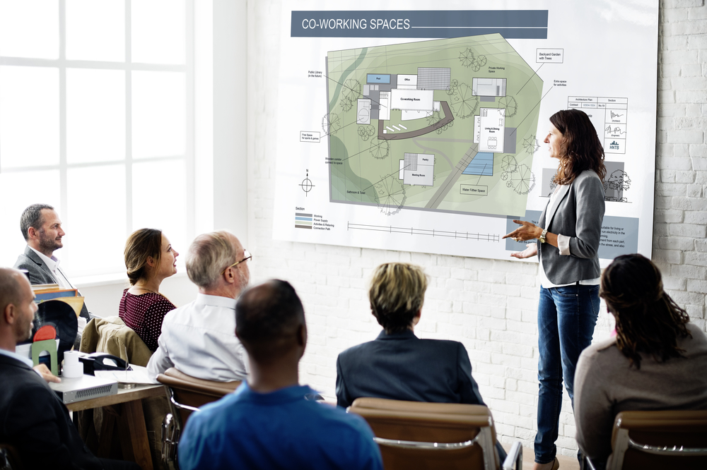
Basic Business Structures
Include:
simple
functional
divisional
matrix
team-based
boundaryless
learning

Slide 50
Simple Structure
Is a non-elaborate structure
Has little formalization
Has a centralized authority
Is a flat organization with only two or three levels
Is widely used in smaller businesses

Slide 51
Simple Structure
Advantages
fast
flexible
inexpensive
accountability is clear
Disadvantages
effective only in small organizations
has few policies and rules to guide operations
can have too much decision-making power at the top level

Slide 52
Functional Structure
Is an expansion of functional departmentalization
Groups employees with similar and related occupational specialties
Is used as a framework for an entire company

Slide 53
Functional Structure
Advantages
productivity and work specialization
job satisfaction
minimizes duplication
Disadvantages
loses sight of employee interests in pursuit of goals
individuals may become isolated and have little understanding of what people in other functions are doing

Slide 54
Divisional Structure
Is composed of self-contained units or divisions
Builds on product departmentalization
Creates divisions which are self-sufficient within given limits
Constructs divisions which are run by division managers or supervisors

Slide 55
Divisional Structure
Advantages
focuses on results
division managers have full responsibility for products and services
frees headquarter staff from being concerned with everyday activities
Disadvantages
duplication of activities and resources
can increase costs
can reduce efficiency

Slide 56
Matrix Organization
Combines the elements of functional and product-based departmentalization creating a dual chain of command
Employees have at least two bosses
Authority is shared between two supervisors
Involves regular communication

Slide 57
Matrix Organization
Advantage
can facilitate the coordination of multiple projects
Disadvantage
confusion associated with chain-of-command which can cause conflict

Slide 58
Matrix Chart Organizer
Design
Production
Sales
Accounting
Project 1
Design
Group
Production
Group
Sales
Group
Accounting
Group
Project 2
Design
Group
Production
Group
Sales
Group
Accounting
Group

Slide 59
Team-based Structure
Consists entirely of work groups and teams which perform an organization’s work
Allows team members to have authority to make the decisions which will affect them
Has no chain-of-command

Slide 60
Team-based Structure
Advantages
allows organizations to listen to the customer
gives many different perspectives from various team members
Disadvantages
the chain of command is not defined which can cause conflict
authority is based within the team

Slide 61
Boundaryless Organization
Is not defined or limited by boundaries or categories imposed by a traditional structure
Blurs boundaries surrounding an organization by increasing its interdependence with its environment
Cuts across all aspects of an organization
Attempts to eliminate vertical, horizontal and inter-organizational barriers
Groups employees to accomplish one common task

Slide 62
Learning Organizations
Have developed a capacity to continuously adapt and change because members take an active role in identifying and resolving work-place issues
employees must collaborate on work activities throughout the organization and have a team oriented work ethic

Slide 63
Selecting a Structure
Consider the following:
size of the business or organization
business purpose
intended outcomes and productivity levels
worker skills and responsibilities

Slide 64
Organizations
Should:
be flexible
evaluate the structure of their organization
avoid frequent restructuring as it causes employee confusion and poor morale
communicate structural expectations to others
publish an organizational chart
provide employee training
conduct employee interviews

Slide 65
Resources
(n.d.). Retrieved October 2, 2008, from U.S. Small Business Administration: www.sba.gov
(1999 - 2008). Retrieved October 3, 2008, from AllBusiness: http://www.allbusiness.com/
Guide to Organizational Charting. (n.d.). Retrieved October 2, 2008, from OrgChart.Net: http://www.orgchart.net/
Management. (2008). Retrieved October 2, 2008, from About.Com: www.management.about.com

Slide 66
Acknowledgements
Executive Producer
Gordon W. Davis, Ph.D.
Assistant Brand Manager
Megan O’Quinn
Amy Hogan
Graphic Designer
Melody Rowell
Brand Manager
Megan O’Quinn
V.P. of Brand Management
Clayton Franklin
CEV Multimedia, Ltd.
© MMXVI

