Slide 2
Advertising
Is a form of paid non-personal promotion
Is used to inform, persuade or remind customers about a specific product, company or idea
Has two basic aspects:
the message – what a business wants to communicate
the medium – the method communication

Slide 3
Types of Advertising Messages
Phrases meant to attract customers
come in and enjoy a …
try our new …
buy now…
Slogans meant to raise brand name awareness
“Dude, you’re getting a Dell!”
Built Ford Tough
Think Outside the Bun

Slide 4
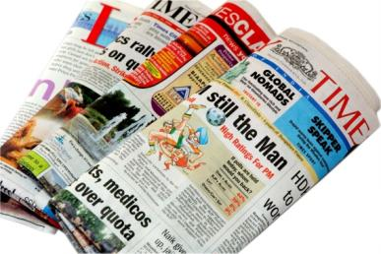
Advertising Media
Include the following:
print media
newspapers, flyers, magazines, trade publications, journals, newsletters, yellow pages and direct mail
broadcasting media
television, radio and movie ads

Slide 5
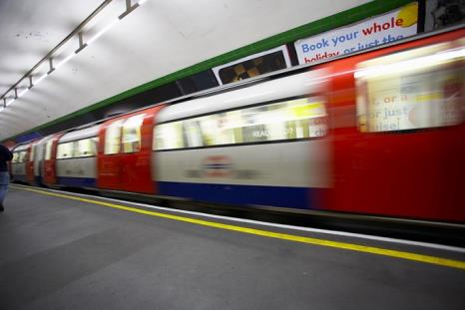
Advertising Media
Include the following:
Internet
website banners, pop-ups, spam and e-mail
outdoor and transit media
billboards, buses, taxis, trucks, cars, subway stations and airline terminals

Slide 6
Advertising Advantages
Increases business awareness
Reaches a wide audience
Uses repetition and product positioning to build customer trust
Entices customers visually

Slide 7
Advertising Disadvantages
Can be impersonal
Is often less effective for “closing the sale”
Can be expensive

Slide 8
Advertising Decisions
Include:
budgeting
how much the ad will cost
frequency
how often the ad will run
medium
which medium should be used for greatest results

Slide 9
Advertising Media Assignment
You will assume the role of managerial team for a large clothing store.
You are to develop an advertising plan and coordinate an in-store promotion to announce the new line of jeans coming this spring.
The jeans are expensive but are endorsed by a 20-something celebrity of your choice.
You are to select a minimum of 3 appropriate advertising media and make suggestions that coordinate your in-store promotion with the selected advertising.
Radio Ad
Television Commercial
Billboard
Newspaper Ad
Web Banner Ad

Slide 10
Advertising Media Assignment

Slide 11
Advertising Media Assignment

Slide 12
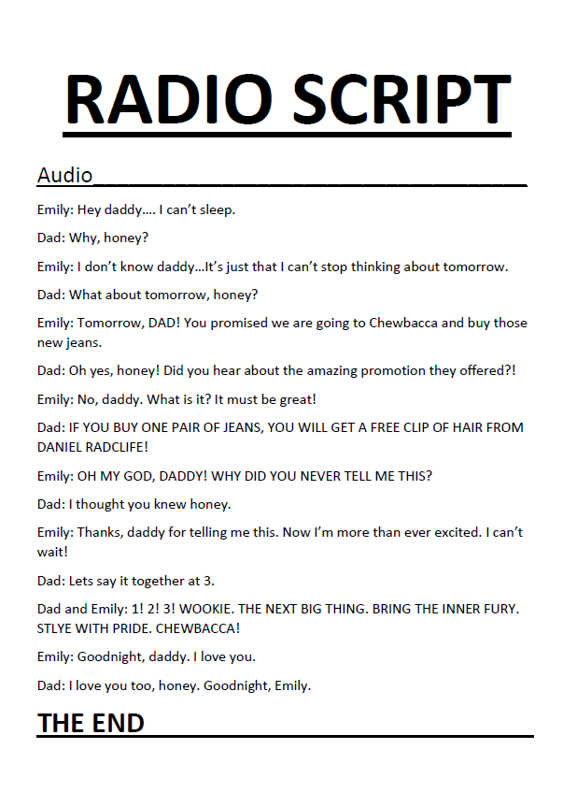
Advertising Media Assignment

Slide 13
Advertising Media Assignment

Slide 14
Advertising Media Assignment

Slide 15
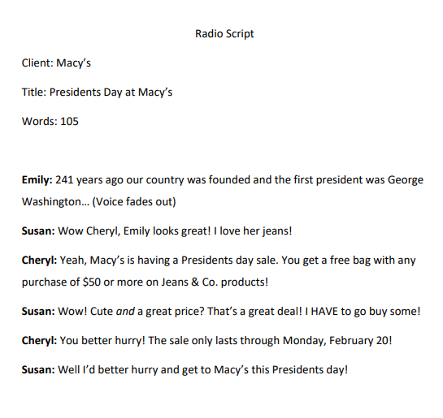
Advertising Media Assignment

Slide 16
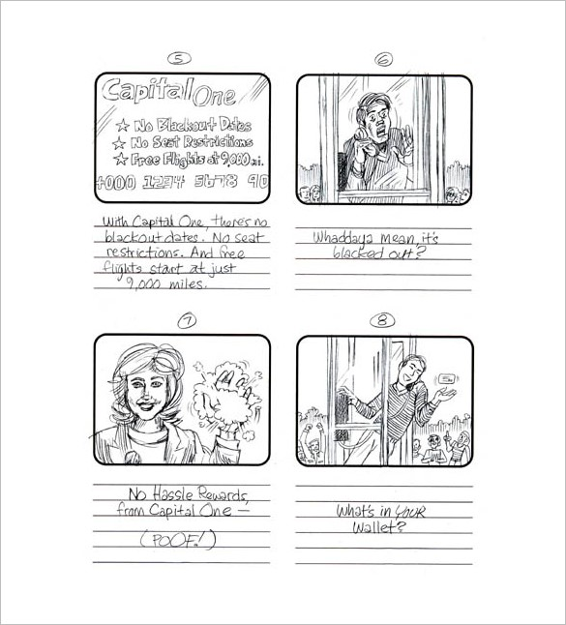
Advertising Media Assignment

Slide 17
Advertising Media Assignment

Slide 18
Acknowledgements
Executive Producer
Gordon W. Davis, Ph.D.
Production Coordinator
Amy Hogan
Megan O’Quinn
Brand Manager
Megan O’Quinn
Graphic Designer
Melody Rowell
Technical Writer
Jessica Odom
V.P. of Brand Management
Clayton Franklin
© MMXIV
CEV Multimedia, Ltd.

